Slide 1
FinTech PPT
By team Afr-Asia: Chinmay B., Glennmark R.,Megh S., Mohammed Taha

Slide 2
Content
Problem
Proposed solution
Ui:client
Data Warehouse
Benford Law
Lowess Regression
Apriori Algorithm

Slide 3
Problem
With the evolution of technology, there have been increasing number of instances where many have been victims of fraudulent transactions around the globe.
With the monolithic/legacy system implemented in majority of the financial institutions (especially nationalized banks)and black hat hackers developing various techniques to infiltrate the system, fraudulent transactions have been taking not only in the front end but even from the backend .
Moreover, recently many Indian banks have faced mergers where 2 or 3 banks merged together in the name of compliance and capital adequacy. This has resulted in various heterogenous data being amalgamated into one single monolithic/unified system which may have been an issue.

Slide 4
Proposed Solution
For the integration of the data we decided to develop a prototype data warehouse in order to amalgamate the desired data in a designated area. The dwh will provide relevant information to relevant department with the help of ETL process queries which will be quite efficient in organizing the data.
In order to solve the financial transaction, we could use mining algorithm collected using the dwh that has been made. The mining algorithms which could be implemented could be regression analysis as well as we could use the classification algorithm and with the aid of Benford law and/or the Apriori algorithm to aid us in identifying the fraudulent transactions
Thus the final product would be a GUI where we can see the organized frequent itemset as well as to display the fraudulent activity we will be displaying the transaction as well as the probability of suspicion simultaneously and the transaction could be listed as per priority based

Slide 5
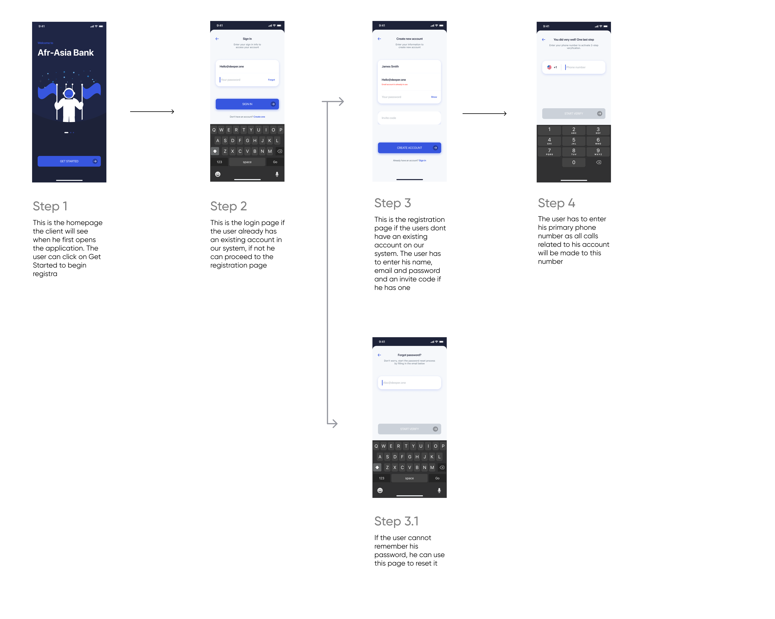

Slide 6
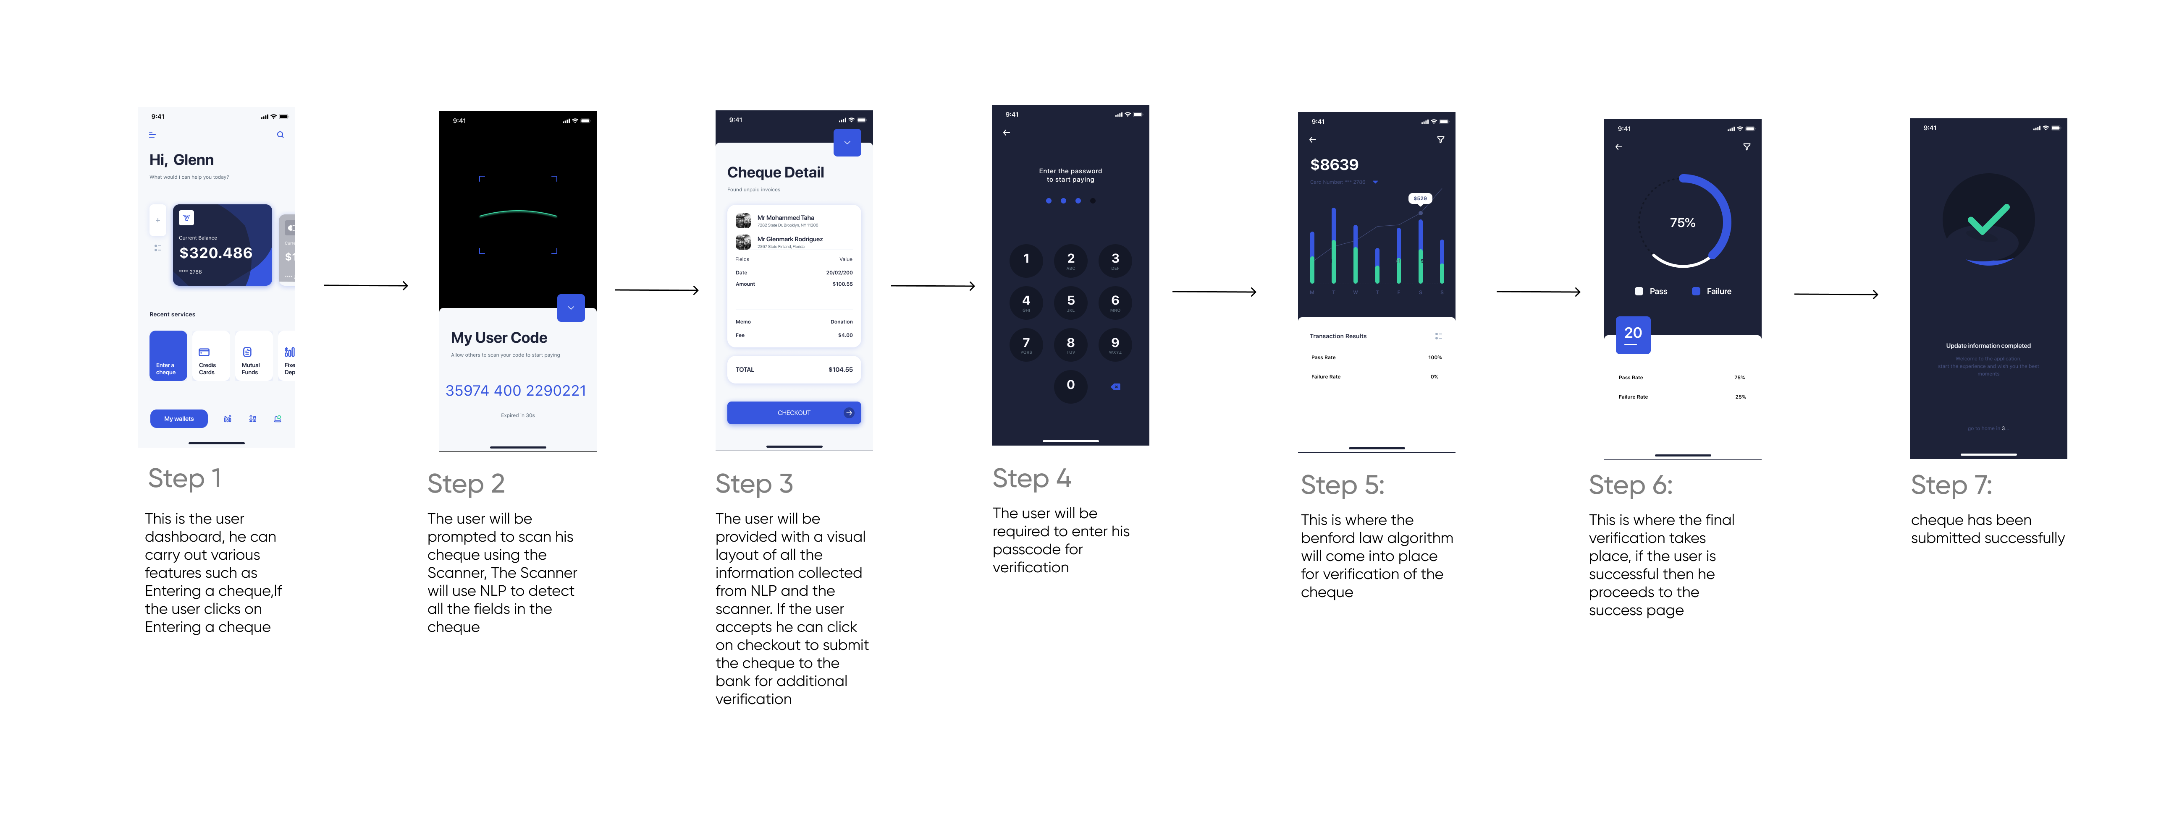

Slide 7
How does the fraud detection work Step 1:
Before we can begin any fraud detection, the customer needs to have an existing account in our application, once he has successfully registered and submitted his credentials to us. He can then avail the feature of Cheque Transfer

Slide 8
How does the fraud detection work Step 2:
Once the user clicks on the cheque transfer button, the application takes him to the Scanner where we use Natural Language Processing (NLP ) and Optical Character Recognition (OCR) to collect all the details from the cheque
The code we plan to use for this technology is available here:
Bank-check-OCR
A python program to extract details from bank check using optical character recognition using python and openCV
pmathur5k10/bank-check-ocr (github.com)

Slide 9
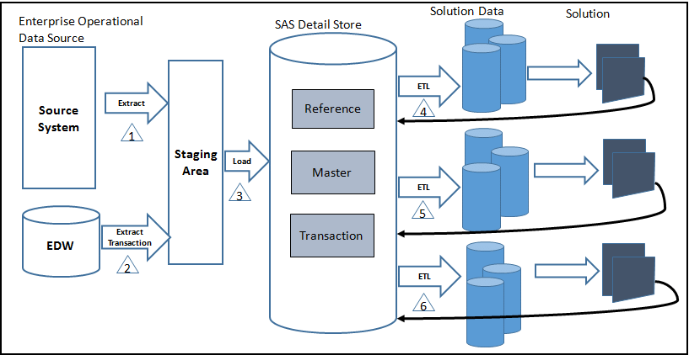
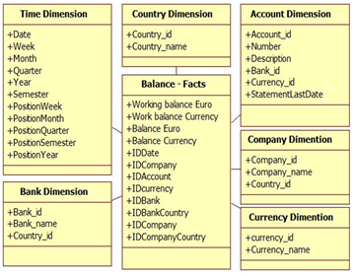
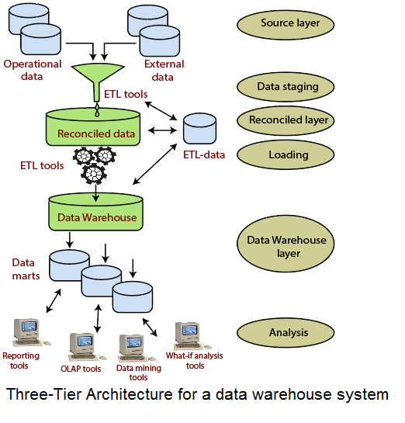
How does the fraud detection work Step 3:
Now all banks use a different format for a cheque, the data is heterogeneous. This is why we need to create a data warehouse to collect all the information from the cheque and then use it to create a homogenous solution
The diagrams below illustrate what this data warehouse could be like for a banking system

Slide 10
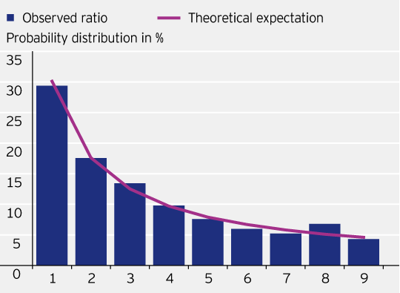
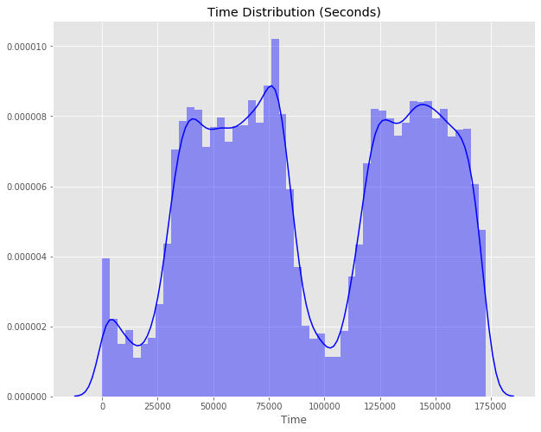
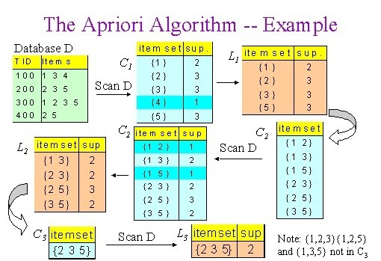
How does the fraud detection work Step 4:
Once the data in its homogenous form has been successfully collected then we will use a combination of tools to analyze if the data in the form is fraudulent or not. These tools are:
Benfords Law
Benford-s-Law_python_code/code at master · eleprocha/Benford-s-Law_python_code (github.com)
CodeDrome/benfords-law-python (github.com)
2) Logistic/ Lowess regression analysis
https://www.kaggle.com/gauravduttakiit/creditcard-fraud-detection-by-logistic-regression
3) Apriori Algorithm
https://www.researchgate.net/publication/223022503_Association_rules_applied_to_credit_card_fraud_detection
A combination of these 3 tools will help us analyze the level of fraudulence of the data, if the data is below lets say 50%, then the application will immediately raise an alert to the respective authorities in a bank and the transaction will be halted, However if the data is not 100% fraudulent free and above 50%, then the transaction will not be halted but still sent to authorities for additional verification. If the data is at 100% then the transaction will be successful

